Slide 1
CAD-to-FAB, Smiths Interconnect, Dundee
SPCD, ESTEC Noordwijk, 15-18th October 2024
No licence required

Slide 2
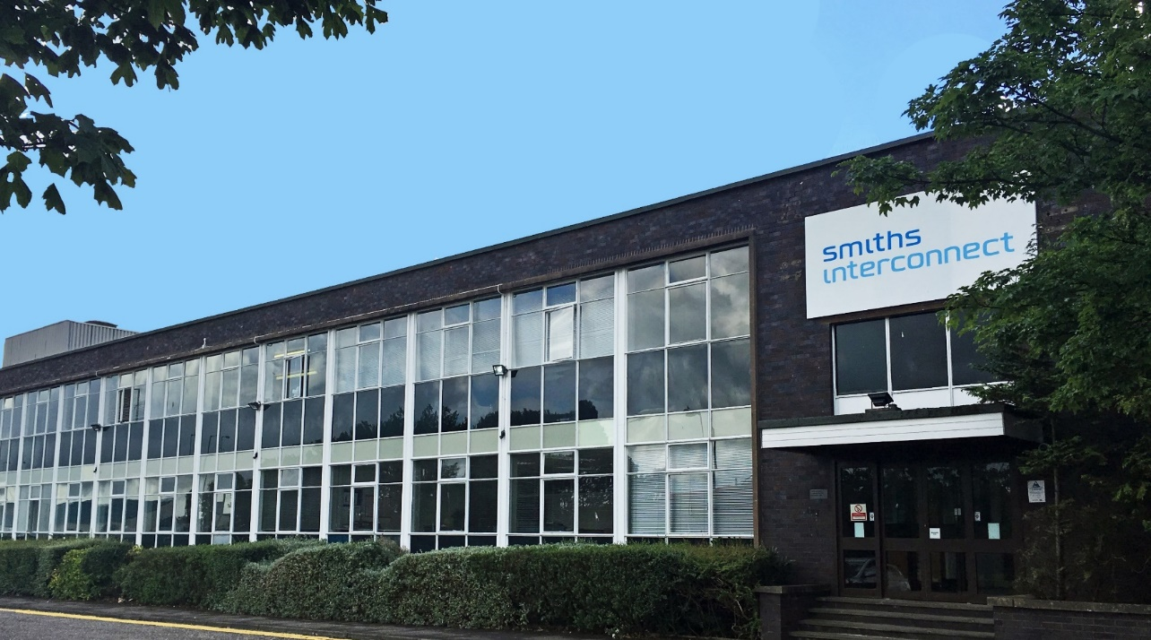
Smiths Interconnect Dundee, Scotland
AS9100 accredited site established in 1969 as Ferranti
Becoming TRAK in 1992
A Smiths Company since 2004
Microwave & RF established reliability passive components and assemblies have been designed and produced on site for 55 years.
Isolators & Circulators
Couplers
RF filters
Employing 74 people in a 4,000 m² facility.
>30 years of space flight heritage delivering over ~240,000 flight.
We are proud to share that we have EEE and equipments aboard
44 deep space missions for ESA, NASA, JAXA & ISRO (most recently Europa Clipper)
~700 orbiting platforms in LEO/GEO & MEO

Slide 3


Problem statement
Traditional RF components, even produced using automation, are ill-suited to a high-mix/ low volume environment, tending to result in prolonged developments, high prototyping costs, large MOQs, and extended production lead-times.
In contrast, direct, computer-controlled manufacturing techniques, additive (e.g., 3D printing) or subtractive (computer-controlled machining or patterning) have flat cost vs. volume curves essentially proportional to the time on the machine and irrespective of the exact nature of the parts being fabricated.
€€€
€€
Traditional
manufacturing
Cost per unit
Digital manufacturing
€
Throughput
10
100
1000
10000
100000
1000000
SPCD, ESTEC Noordwijk, October 2024

Slide 4
CAD-to-FAB investment motivation
SWaP-C (size, weight, power and cost) is driving the need for the integration of passive functions including ferrite isolators/circulators, RF filters and couplers as components or as multi-function assemblies.
We report initial results of a novel digital manufacturing process combining both substrative and additive computer-controlled fabrication of planar passive RF devices.
We refer to this capability as CAD-to-FAB.
The prototype CAD-to-FAB system is up and running.
The full-scale system is on schedule to be commissioned in SINT Dundee by Q1 CY2025 and represents a 2.8M€ investment.
This new manufacturing capability has been used to realise high-performance passive RF components operating in S to K-Bands - the end stop of the capability is expected to be 40-50GHz (TBC).
currently being focused on developing SMT components operating from C to Ka-bands enabling the economies of scale required for BFN and radar arrays for terrestrial and space applications.
SPCD, ESTEC Noordwijk, October 2024

Slide 5
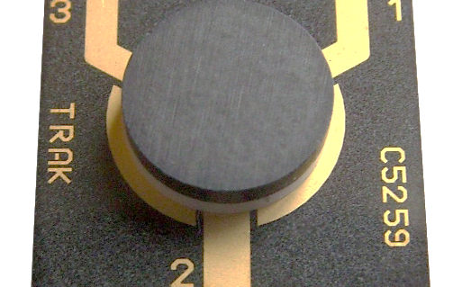
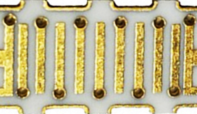
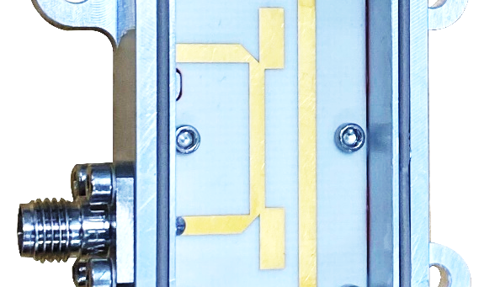
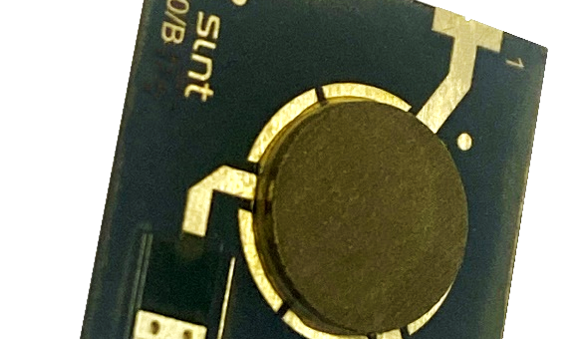
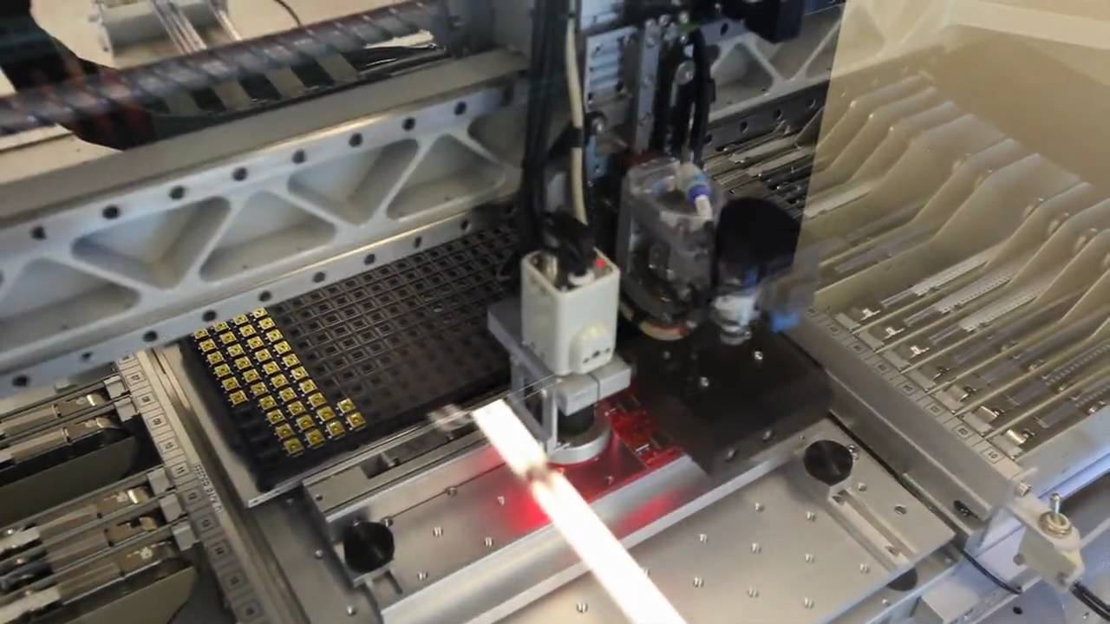
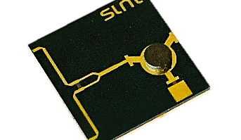
Planar structures being produced using CAD-to-FAB
“Microstrip” isolators & circulators
Planar RF filters
Co-planar waveguide or microstrip interfaces
Wire-bondable (Au) or solderable (Ag)
Illustration
X-Band 50W CW CPWG circulator
Co-planar waveguide or microstrip interfaces
Wire-bondable (Au) or solderable (Ag)
Illustration
X-Band SMT bandpass filter
RF couplers
SMT isolators & circulators
SMT/ packaged directional, hybrid, Wilkinson etc
Wire-bondable (Au) or solderable (Ag)
Illustration
S-Band 30dB directional coupler
C to Ka-Band
Illustration
C-Band SMT isolator with printed termination
Robotic assembly
Integrated assemblies
Automated assembly
Generation 1 assembly COBOT to be replaced in December 2024 with automated pick and place capability
Co-planar waveguide or microstrip interfaces
Wire-bondable or solderable
Illustration
Ku-Band 2-channel isolated combiner
SPCD, ESTEC Noordwijk, October 2024

Slide 6
CAD-to-FAB overview
Aimed at creating a cost-effective, automated production capability to produce planar, passive
Microstrip & SMT non-reciprocal single & dual-junction devices.
“Printed” and suspended substrate stripline RF filters.
Couplers and power combiners/ splitters.
Multi-Function Assemblies (MFAs) combining the above.
Driving this investment program was the desire to
Leverage the digital manufacturing paradigm providing economies of scale and faster time-to-market.
Develop new classes of highly customised products.
Create substantial and scaleable production capacity.
De-sensitize the business to potential supply chain “insecurity” by “on-shoring” critical production processes.
SPCD, ESTEC Noordwijk, October 2024

Slide 7
CAD-to-FAB: 1st of class component
C-Band 25Wpk SMT isolator

Slide 8

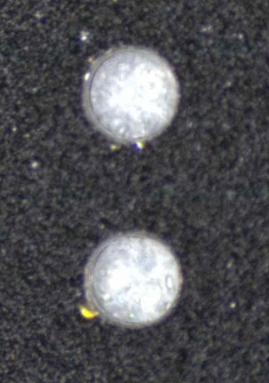

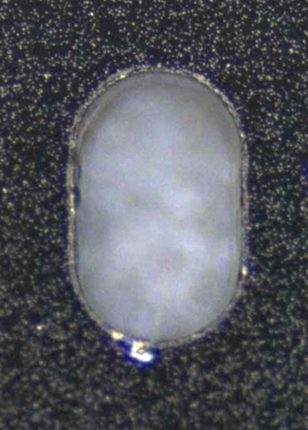

CAD-to-FAB example: C-Band SMT 25Wpk isolator
Raw ferrite is procured in wafer form.
Low Kerf angle “Holes” and “slots”, which will later become ground vias or SMT RF signal interfaces, are created.
Metallisation, dependent on whether wire-bondable or SMT interfaces are required, is applied to the wafer.
300um
WIRE BONDABLE
SMT
600um
Raw ferrite wafer or substrate (procured)
Creation of holes & slots: example of ferrite wafer with 300um diameter holes and 600um length oval slot.
Wafer metallization: based on Au or Ag
SPCD, ESTEC Noordwijk, October 2024

Slide 9

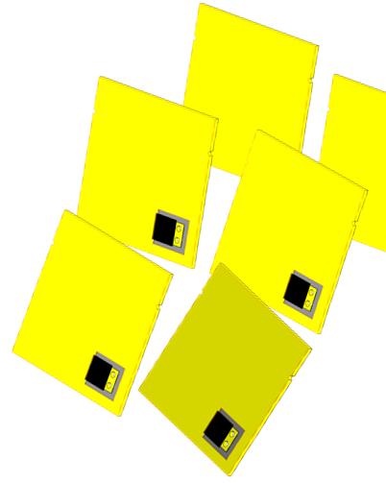
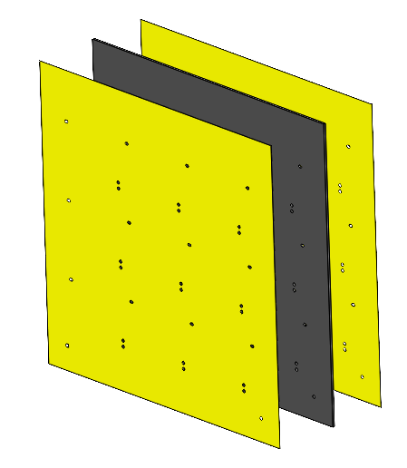
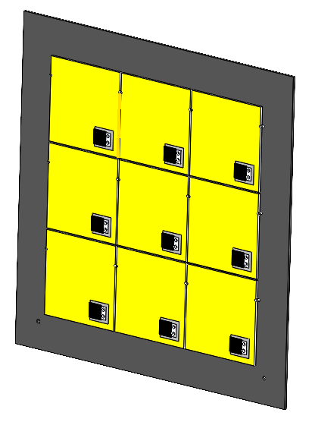

CAD-to-FAB example: C-Band SMT 25Wpk isolator
Resistive elements: where required, terminations or resistors are applied before the wafer is singulated.
CAD-to-FAB v1.0 singulates at this stage.
CAD-to-FAB v2.0 (the full-scale production system) will singulate, using automated dicing, at the final stages of assembly.
Raw ferrite wafer
~2 x 2 inches
Metallization on 2 faces
Resistive elements are deposited (where required)
Wafer with 50 Ohm terminations added
Singulated tiles before patterning
SPCD, ESTEC Noordwijk, October 2024

Slide 10
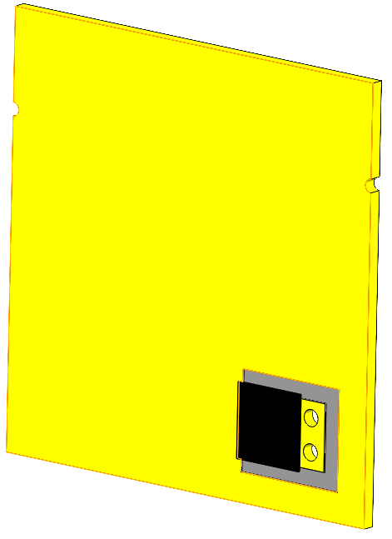
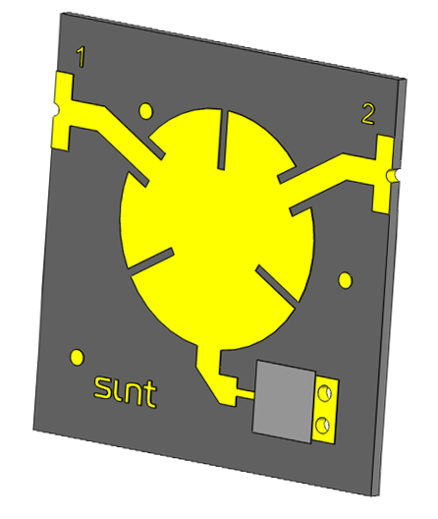
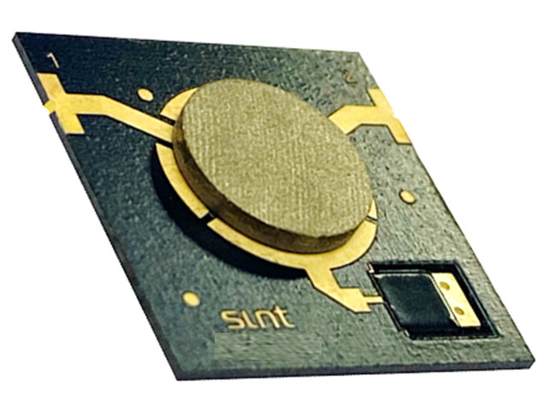
CAD-to-FAB example: C-Band SMT 25Wpk isolator
Metallisation is removed from both faces to create the RF pattern, “written” to an accuracy of +/- 5 um.
Assembly is fully automated (including epoxy dispensing) - pick and place components are positioned to +/-5um accuracy.
Automated machine vision inspection is employed during assembly and on the final assembled product.
RF testing will be undertaken on a sample testing basis.
Isolator assembled using pick & place
With automated visual inspection, tape & reel
Singulated tile pre patterning
Pattern creation on both sides of the tile/wafer
SPCD, ESTEC Noordwijk, October 2024

Slide 11
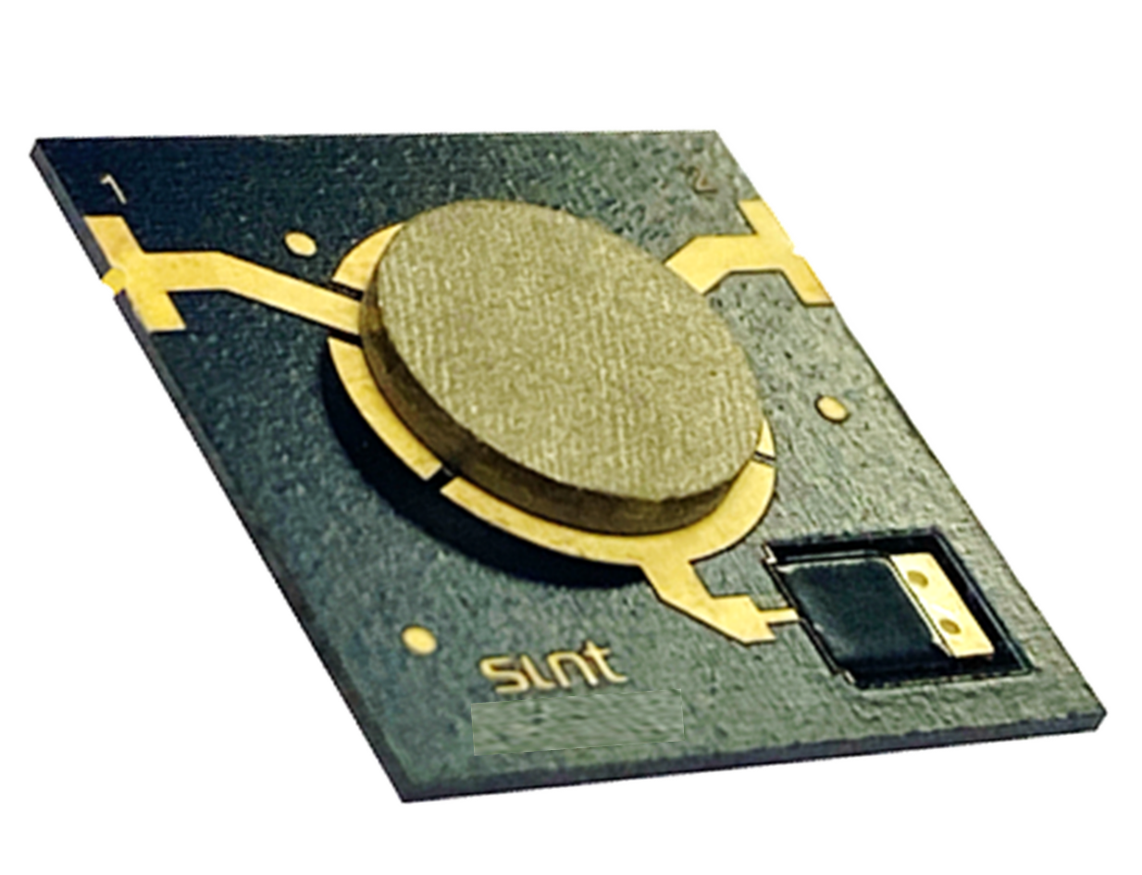
CAD-to-FAB example: C-Band SMT isolator now in serial production
Compact & low profile
Size: 13 x 13 x 1.5mm
Mass: 0.6g max
Simplicity
3 piece-parts excluding epoxy
Readily produced at scale
Consistency
Tuneless and broadband
50Ohm dc bleed path
Integration friendly
Tape & Reel packaging
Reflow solder suitable
Accurate fiducial markers (x3)
SPCD, ESTEC Noordwijk, October 2024

Slide 12
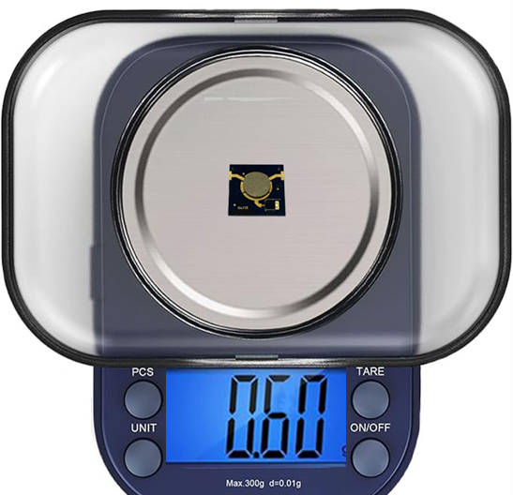
CAD-to-FAB example: C-Band SMT 25Wpk isolator – typical test results (+20C, VNA power)
dB
dB
NB: insertion phase and group delay are plotted over a narrower band
deg.
ns
SPCD, ESTEC Noordwijk, October 2024

Slide 13
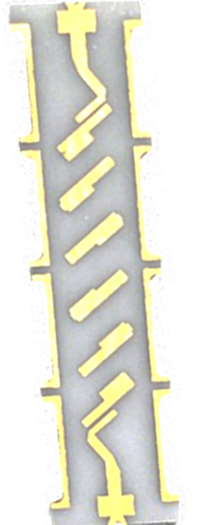
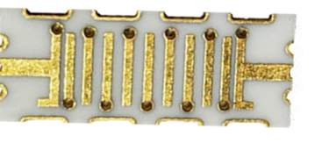
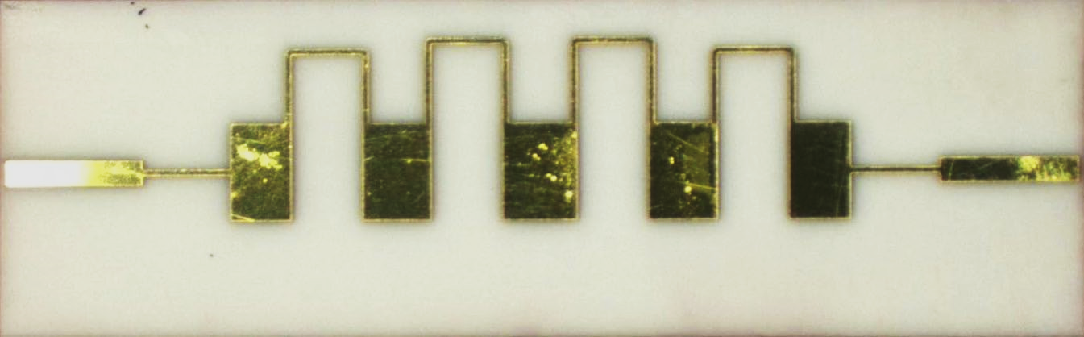
CAD-to-FAB example: other products – planar filters, couplers, etc
In addition to non-reciprocal devices realized in either SMT or microstrip, CAD-to-FAB enables
RF directional, hybrid and Wilkinson couplers as microstrip or SMT devices.
Planar RF filters (interdigital, coupled line).
measurements demonstrate that RF filters produced using CAD-to-FAB result in similar RF performances to devices produced using traditional photolithography and wet etching.
Ultra accurate packaged suspended substrate stripline, coupler circuits
Multi-functional assemblies of the above
100um line width
CAD-to-FAB: coupled line and interdigital SMT filters
CAD-to-FAB: illustration of line width capability (thin film)
SPCD, ESTEC Noordwijk, October 2024

Slide 14
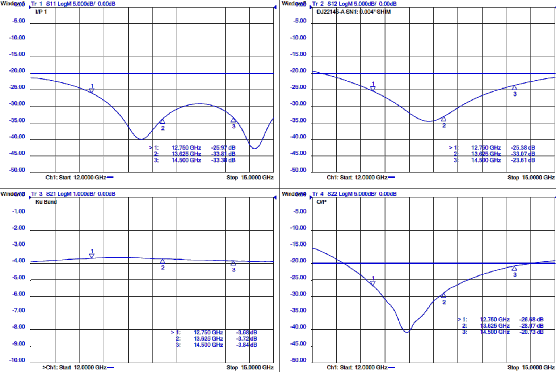
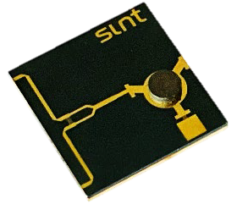
CAD-to-FAB example: other products – printed Ku-Band power splitter
CAD-2 FAB ferrite isolator, termination and Wilkinson power splitter
SPCD, ESTEC Noordwijk, October 2024

Slide 15
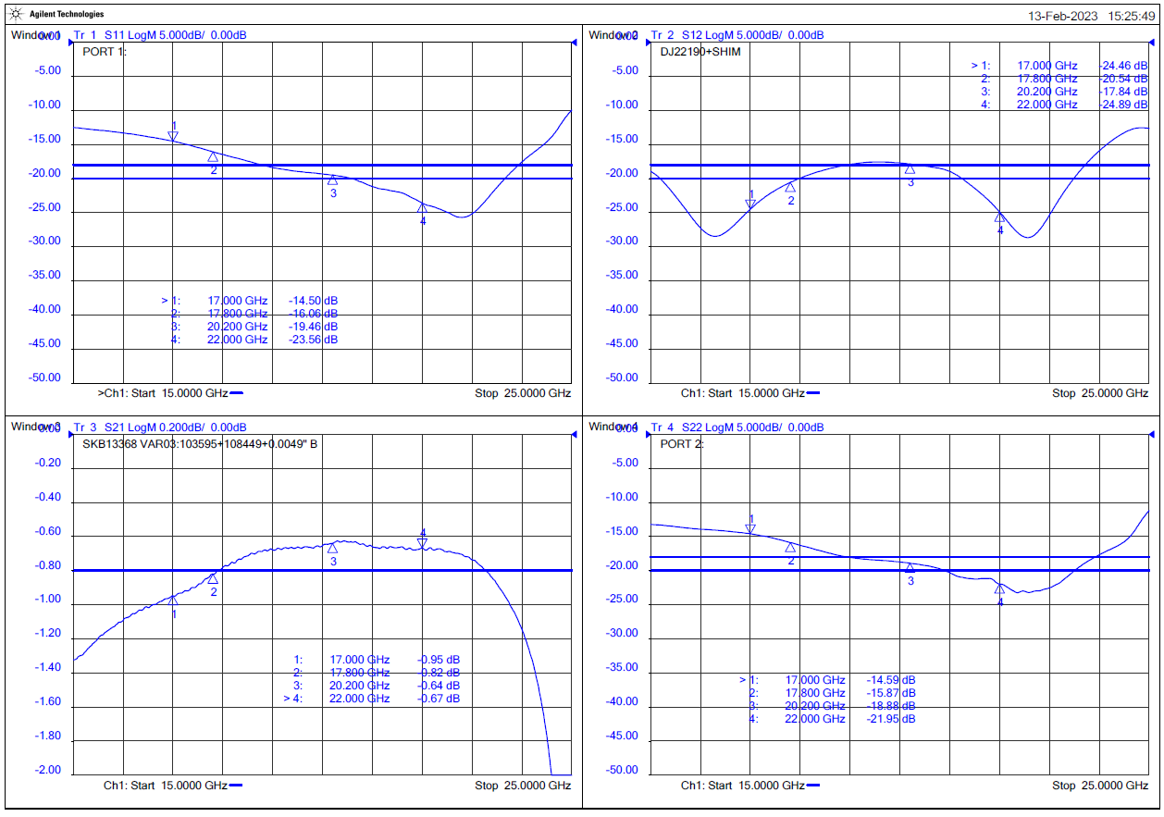
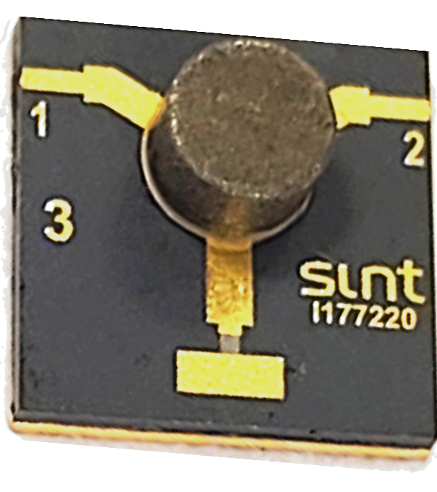
CAD-to-FAB SMT Roadmap
Initially limited to C, X, K & Ka-Bands
C-Band isolator & circulator complete
X-band circulator _Q3 CY2024
K-Band isolator _Q4 CY2024
Ka-Band isolator _Q1 CY2025
No current plans to attempt a classic space qualification approach
Materials are space qualified
The process of mounting an SMT part is part of the qualification challenge and cannot be replicated by SINT Dundee
This microstrip isolator is the precursor to a SMT solution (17.3-21.2GHz). The SMT version is in development including replacing the hi-resistance termination with a 50 Ohm bleed path type.
SPCD, ESTEC Noordwijk, October 2024

Slide 16
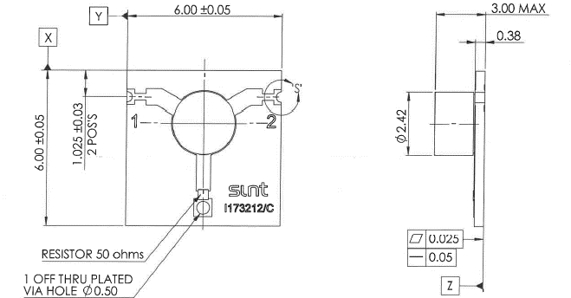
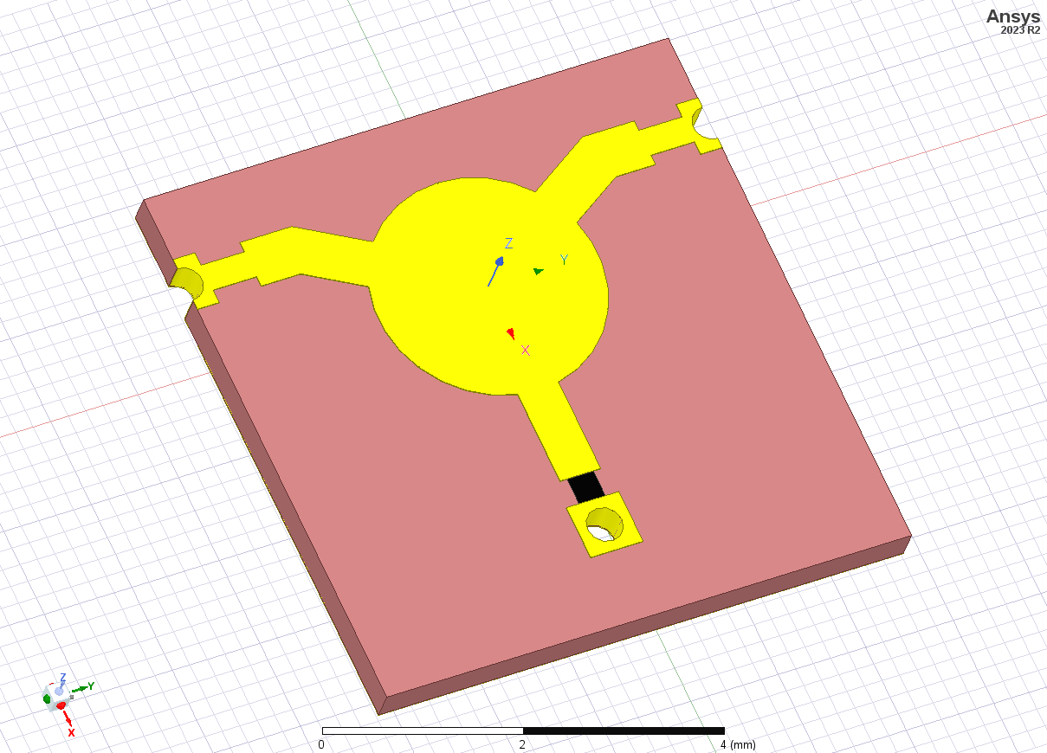
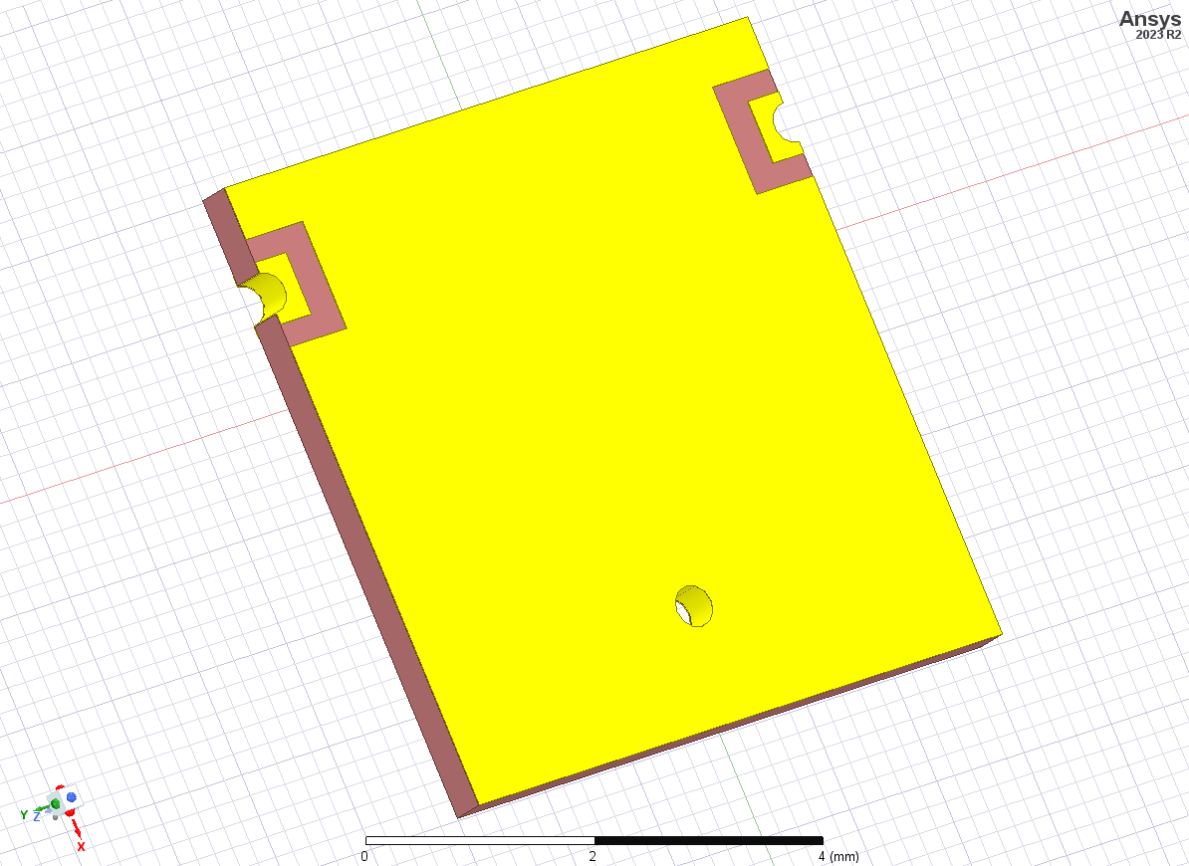
SMT Roadmap
Initially limited to C, X, K & Ka-Bands
C-Band isolator & circulator complete
X-band circulator _Q3 CY2024
K-Band isolator _Q4 CY2024
Ka-Band isolator _Q1 CY2025
No current plans to attempt a classic space qualification approach
Materials are space qualified
The process of mounting an SMT part is part of the qualification challenge and cannot be replicated by SINT Dundee
An SMT isolator targeting 17.3-21.2GHz is the next step
SPCD, ESTEC Noordwijk, October 2024

Slide 17
CAD-to-FAB example: Summary of progress
Observations & notes
Costs are in trending towards expectations using the prototype facility
Electrical characteristics are exceeding expectations generally and especially in terms of consistency
Primary S-parameters
Second order parameters – insertion phase and group delay
Capacity is expected to be ~180k planar high mix devices per shift, per annum (microstrip, SMT).
Non-reciprocal devices
Filters
Couplers
Multi-function assemblies
No additional human resources required as
Substrate processing, Assembly, and inspection will be fully automated
Electrical test could be as low as 0.1% or removed altogether for the simplest components.
Next steps (2025)
Automated test
Automated tape and reel

Slide 18



Acknowledgements
Smiths Interconnect acknowledges the support of the United Kingdom Space Agency (UKSA) through its Space Cluster Infrastructure Funding (SCIF) program contributed £1.9M, matched with a similar amount from Smiths Group, enabling the creation of the CAD-to-FAB facility and the expansion of the Smiths Interconnect, Dundee Space Qualification Laboratory.
SPCD, ESTEC Noordwijk, October 2024

Slide 19

Smiths Interconnect Proprietary Information – For Exclusive Use of the Addressed Party Only

